Slide 1

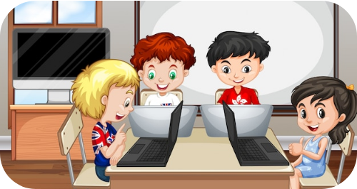
Introduction to Multimedia
Fun with Technology for Grade 1!

Slide 2

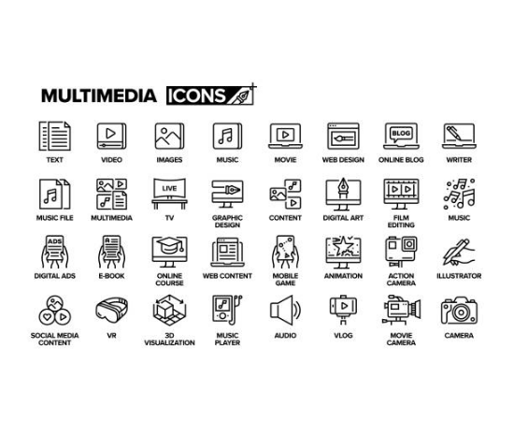
What is Multimedia?
Multi + Media
Multi means "More than one".
Media means "Ways to share ideas".
Multimedia uses text, sound, video, and images to share information!

Slide 3


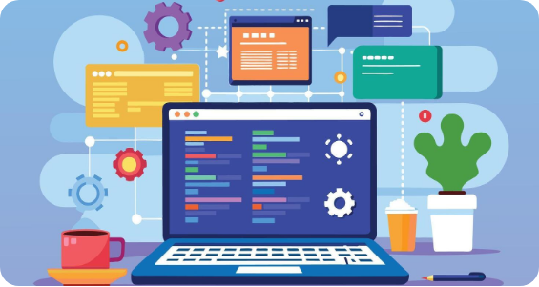
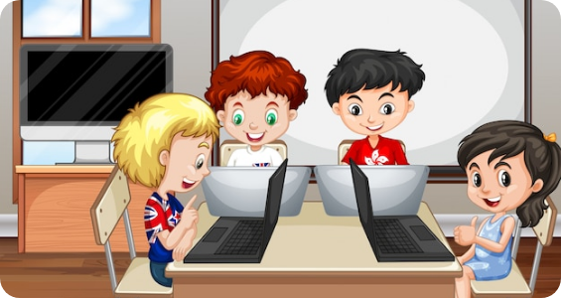
Devices We Use
Laptops
Computers
Small and portable computers.
Found on desks at home or school.

Slide 4
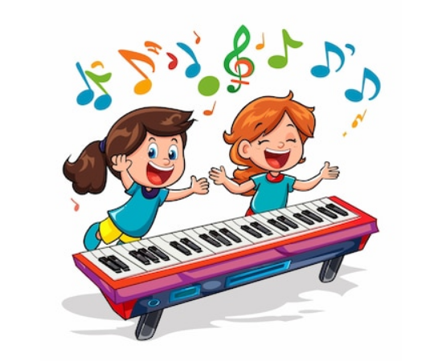


1. Text Files
Text files have letters and numbers.
We see them in sentences.
We use a Keyboard to type!

Slide 5




2. Audio Files
Music
Sounds
Listen to your favorite songs.
Recorded voices and speech.

Slide 6
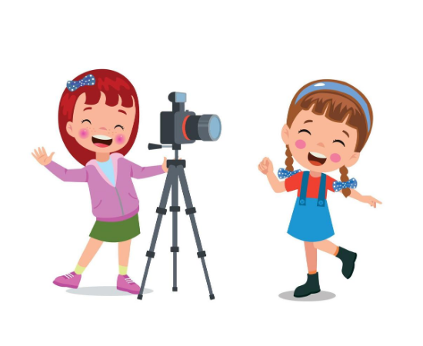

3. Video Files
Videos are moving pictures.
We can record with a camera.
Watch movies and short clips.

Slide 7



4. Image Files
Drawings
Photos
Created with digital software.
Captured by digital cameras.

Slide 8
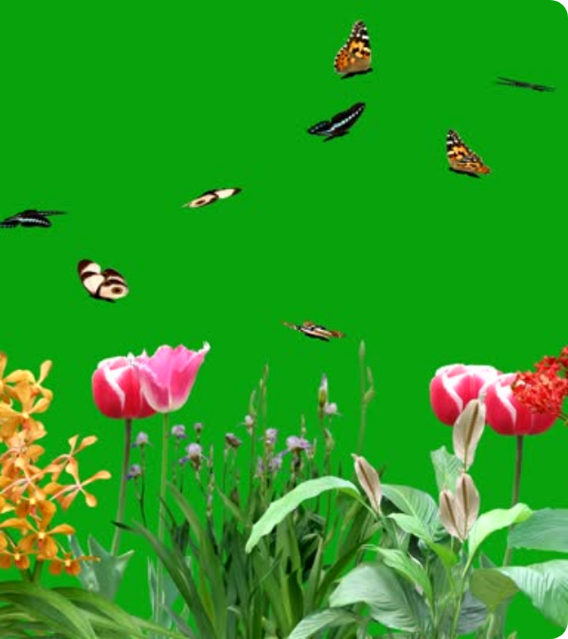

Animation
Animation makes many images look like they are moving!
Think of your favorite cartoon characters jumping and playing!

Slide 9


Helpful Software
We use different apps to open files:
Notepad for text.
MS Paint for drawings.
Media Player for songs and videos.

Slide 10


Using Image Tools
Zooming!
Use the (+) to make images bigger.
Use the (-) to make them smaller.
Use arrows to go to the next picture!

Slide 11





Play and Pause
Play
Pause
Start the video!
Stop for a moment!

Slide 12

Any Questions?
Great job today, Little Explorers!

Slide 13






Image Sources
https://img.freepik.com/free-vector/students-working-computer-room_1308-30865.jpg
Source: www.freepik.com
https://media.istockphoto.com/id/2169229673/vector/multimedia-line-icon-set-group-of-object-video-music-audio-movie-text-content.jpg?s=612x612&w=0&k=20&c=J4dtPmjCG5kIbu4S5TmSuRY46H_rcxky3SuOZf_CuMM=
Source: www.istockphoto.com
https://static.vecteezy.com/system/resources/previews/046/884/997/non_2x/a-cartoon-illustration-of-a-laptop-displaying-web-development-code-with-icons-and-a-plant-on-the-desktop-free-vector.jpg
Source: www.vecteezy.com
https://img.freepik.com/premium-vector/cartoon-picture-two-children-playing-keyboard-with-music-notes-it_951778-76197.jpg?w=360
Source: www.freepik.com
https://static.vecteezy.com/system/resources/thumbnails/025/787/291/small/3d-realistic-microphone-smartphone-laptop-headphone-and-audio-speaker-in-plastic-cartoon-style-illustration-vector.jpg
Source: www.vecteezy.com
https://static.vecteezy.com/system/resources/previews/020/907/554/non_2x/cute-boys-taking-photo-using-smartphone-and-camera-cartoon-illustration-vector.jpg
Source: www.vecteezy.com

Slide 14



Image Sources
https://media.istockphoto.com/id/1340833738/video/flying-butterflies-in-a-garden-with-green-screen-background.jpg?s=640x640&k=20&c=EU733lNA5MwIS8RnKS_Y54y3iyTFwFySoLAgBLEvKHo=
Source: www.istockphoto.com
https://i.ytimg.com/vi/DF4TLzvJ0gw/maxresdefault.jpg
Source: www.youtube.com
https://png.pngtree.com/png-vector/20221118/ourmid/pngtree-cartoon-play-button-illustration-with-splash-effect-pause-panel-media-vector-png-image_41241646.jpg
Source: pngtree.com

